Slide 1
Prediction, Monitoring and Personalized Recommendations for Prevention and Relief of Dementia and Frailty

Slide 2
COMFORTAGE – Prediction, Monitoring and Personalized Recommendations for Prevention and Relief of Dementia and Other Neurodegenerative Diseases

Slide 3
EC Call and Topic
Call title | The Silver Deal - Person-centred health and care in European regions (2 proposals were accepted)
topic id | HORIZON-HLTH-2023-STAYHLTH-01-01
Expected outcomes | Citizens and patients will get effective, preventive, integrated, coordinated, evidence-based and people-centred high-quality health and care services to identify and tackle or prevent multi-morbidities, frailty, biologically or mentally reduced capacities, (sensory) impairments, dementia and/or neurodegeneration, fostering mental and physical health, wellbeing and quality of life. Primary and community-based health and care services will be better equipped to early identify people at risk of developing non-communicable diseases (NCDs) and multi-morbidities . They will have integrated and cost-effective intervention tools to help prevent, monitor and manage progression of age-related diseases, conditions and disabilities, while promoting healthy lifestyles, ageing in place[1], as well as physical and mental wellbeing among the elderly. Older people, including those receiving long-term care, will be empowered to take an active role in the management of their own physical and mental health, as well as increase their social interactions and wellbeing through better health literacy, educational programmes, trainings and platforms, including with the help of innovative and digitally enabled solutions . Citizens, all relevant stakeholders, public authorities, cities and rural environments, as well as health care providers will be engaged to ensure the introduction to and the integration of age-friendly , mental and physical health promoting innovative care pathways and digitally enabled solutions into the daily life and wellbeing of the ageing population, with the aim of leaving no-one behind.
SCOPE | This topic aims to implement strategies and actions in line with the Green Paper on Ageing[2], the EU Long-term care report[3], the ‘Healthier Together’ – EU Non-Communicable Diseases Initiative[4], the new EU Care Strategy[5], which strive to address demographic change and enable better health and care for Europe’s growing ageing societies, as well as to harness the potential of the Silver Economy[6]. NCD prevention is highly relevant to reduce the need for long-term care. New tools and integrated care models are needed, reinforcing primary, community- and home-based health and long-term care provision, through better early detection and management of diseases among older people in an increasingly ageing society and overburdened health and care systems.
COMFORTAGE – Prediction, Monitoring and Personalized Recommendations for Prevention and Relief of Dementia and Other Neurodegenerative Diseases

Slide 4
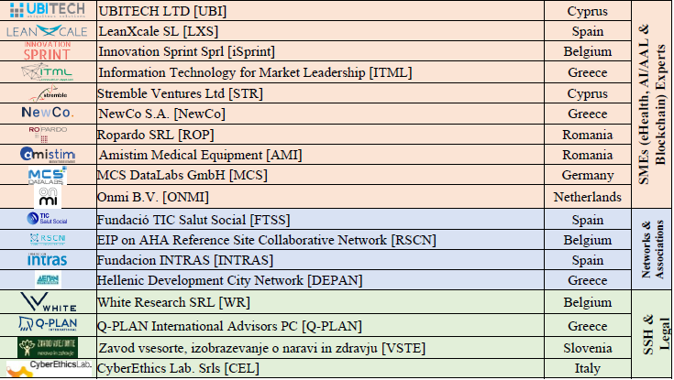
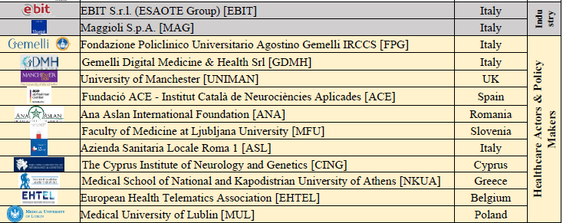
Consortium
39 Partners from 12 Countries
8 Research Institutions/Universities
11 Healthcare Organizations & Actors
12 Industries and SMEs
4 Social Multipliers and Associations
4 SSH and Legal Organizations
COMFORTAGE – Prediction, Monitoring and Personalized Recommendations for Prevention and Relief of Dementia and Other Neurodegenerative Diseases

Slide 5
Project Overview
Proposed Start – End dates: January 1, 2024 –December 31, 2027 (48 months) (consortium agreement???)
Deadline for first version of the grant agreement data (incl. annexes) 08/09/2023
Deadline for the signature of the participants certified declarations 15/09/2023
Deadline foreseen for the signature of the grant agreement 04/11/2023
3 Reporting Periods
Payment Allocation
70-75% on the GA signing
5-10% on each of the 2 Interim Payments
10% on the Final Payment
COMFORTAGE – Prediction, Monitoring and Personalized Recommendations for Prevention and Relief of Dementia and Other Neurodegenerative Diseases

Slide 6
Project Pillars
Development of the patients’ stratification model and definition of the key factors requirements for tools to be developed
COMFORTAGE
Patient Stratification
Training and Digital Literacy
Personalized Care Models
Health & Social Innovation
Support wider adoption and market innovation of integrated health and care solutions
Design and deploy of personalized progression, prevention, and intervention care models and tools
Establish educational and training materials and activities
COMFORTAGE – Prediction, Monitoring and Personalized Recommendations for Prevention and Relief of Dementia and Other Neurodegenerative Diseases

Slide 7
Project Concept
Introduce a holistic framework that will focus on the prevention and relief of dementia and frailty.
Utilize leading data sources to generate the initial recruitment stratification, define inclusion/exclusion criteria, guide requirements analyses and parameterize the initial design and implementation of the tools.
Stratify patients based on personalized prognosis of the disease progression.
Improve Wellbeing and Quality of Life (QoL) through personalized interventions, suggestions, care plans and improved patient monitoring and follow-up.
Provide to the patients and their caregivers targeted tools, educational programs and platforms, trainings and activities.
Provide a concrete and multidisciplinary Health Technology Assessment (HTA) approach
COMFORTAGE – Prediction, Monitoring and Personalized Recommendations for Prevention and Relief of Dementia and Other Neurodegenerative Diseases

Slide 8
Project Objectives
PRIMARY AND COMMUNITY-BASED
HEALTH AND CARE SERVICES
EVIDENCE-BASED
HEALTH POLICIES
DEMONSTRATING
COST-EFFECTIVENESS
UTILIZATION OF LARGE-SCALE PRIMARY DATA SOURCES AND OF LONGITUDINAL OBSERVATIONAL STUDIES
EVIDENCE-BASED HEALTH POLICIES CREATION, ASSESSMENT, MONITORING AND OPTIMIZATION
INTRODUCING A HOLISTIC HEALTH TECHNOLOGY AND IMPACT ASSESSMENT FRAMEWORK
1
2
3
4
5
6
PROMOTING A HOLISTIC
DIGITAL CARE PATHWAY
PREVENTIVE AND INTEGRATED
CARE MODELS
EMPOWERMENT
& IMPROVEMENT OF
HEALTH AND DIGITAL LITERACY
PROVIDING A HORIZONTAL DIGITAL CARE PATHWAY THROUGH INTEGRATED CARE MODELS
DESIGN AND IMPLEMENTATION OF INTEGRATED PREVENTION AND INTERVENTION TOOLS FOR FOSTERING MENTAL AND PHYSICAL HEALTH, WELLBEING AND QoL
ESTABLISH TRAINING CENTRE AND EDUCATIONAL PLATFORM

Slide 9
Work Plan
COMFORTAGE – Prediction, Monitoring and Personalized Recommendations for Prevention and Relief of Dementia and Other Neurodegenerative Diseases

Slide 10
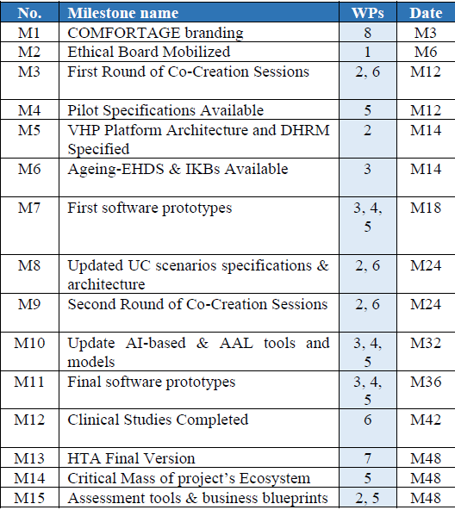
Work Plan Overview
8 WPs – 44 Tasks
70 Initially Allocated Deliverables
15 Milestones
COMFORTAGE – Prediction, Monitoring and Personalized Recommendations for Prevention and Relief of Dementia and Other Neurodegenerative Diseases

Slide 11
Use Case – Pilot Partners
Category #A – Study of Causal Risk Factors Towards Early Diagnosis and Community Based Primary Prevention of Dementia (5 use cases)
Different Categories of Pilot Partners
1
Medical partners, policy makers, digital innovation hubs (i.e., smart homes etc.), large-scale networks/associations/multipliers
Category #B - Study of the association between the development of dementia and other health-related conditions (1 use case)
2
13 Pilot Partners
Category #C – Study of Improved and Personalized Interventions that can Delay and Relief Dementia (2 use cases)
From 9 countries ranging from East Europe to West Europe and from North to South
Category #D – Study of Neuromechanics and Falls Prevention (2 use cases)
3
Different pilot scenarios/use cases
5 different categories of scenarios have been identified so far. 4 Clinical Trials 1) Medical/Clinical studies, 2) Digital Innovation Hubs, 3) Large-Scale Social Multiplication
Category #E – Active-Ageing Observatory: Study of Digital Innovation Hubs and Living Labs for improving wellbeing and QoL (3 use cases)

Slide 12
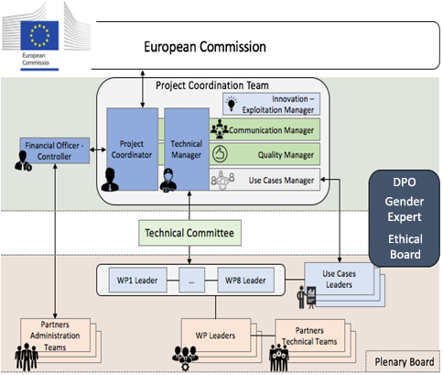
Project Management Structure
Project Coordinator: University of Piraeus Research Centre (UPRC) - George & Dimos
Technical Manager: Maggioli S.p.A. (MAG)
Scientific Manager: Stremble Ventures Ltd (STR)
Pilot Manager: Fondazione Policlinico Universitario Agostino Gemelli (FPG)
Pilot Cluster Managers
Category #A: University of Manchester (UNIMAN)
Category #C: The Cyprus Institute of Neurology and Genetics (CING)
Category #D: Ana Aslan International Foundation (ANA)
Category #E: Aristotle University of Thessaloniki (AUTH)
Ethics Manager: CyberEthics Lab (CEL)
Exploitation Manager: European Health Telematics Association (EHTEL)
Dissemination Manager: Fundacion INTRAS (INTRAS)
Innovation Manager: European Health Telematics Association (EHTEL)
COMFORTAGE – Prediction, Monitoring and Personalized Recommendations for Prevention and Relief of Dementia and Other Neurodegenerative Diseases

Slide 13
Issues on the GAP
SME owners budget and effort allocation
Requests received by Q-PLAN and CEL. Others???
Finalization of procedures from EC’s Validation Services
PIC change on The Cyprus Institute of Neurology and Genetics (CING) partner
Gemelli Digital Medicine & Health Srl (GDMH) to be issued as Affiliated Entity to Fondazione Policlinico Universitario A. Gemelli (FPG)
Ethics Check will be scheduled by the HaDEA during the implementation of your project and after the submission of the first version of deliverable Ethical Management Framework at M12. This will entail the review of all ethics deliverables submitted by M12, including the first version of D7.1, to be submitted by M6. => Ethics WP (created by or PO) add a respective Deliverable
COMFORTAGE – Prediction, Monitoring and Personalized Recommendations for Prevention and Relief of Dementia and Other Neurodegenerative Diseases

Slide 14
COMFORTAGE Methodology Phases
01
Factors Analysis
Prevention & Diagnosis
Identification of the causal factors contributing to the development of dementia
Patient stratification and prevention targeting common causal pathways will reduce the risk factor for later dementia
04
02
Monitoring & Follow-Up
Treatment & Intervention
People-centric assistive technologies improving wellbeing and QoL
Integrated and personalized health care intervention models
03

Slide 15
Medical Partners
COMFORTAGE – Prediction, Monitoring and Personalized Recommendations for Prevention and Relief of Dementia and Other Neurodegenerative Diseases

Slide 16
Clinical Methodology
Provide Prevention/Intervention Measures
Continuous Learning
Monitor Risk, Collect feedback, deliver targeted prevention & intervention measures
Assessment and revisions in the personalized recommendations
Prior to enrollment
Analyze Impact
Study Assessment
Analyze and define study exclusion/inclusion criteria. Obtain informed consent. Screen study participants by criteria and organize by risk
Analyze the impact of personalized recommendations and interventions and perform dynamic revisions in the care and treatment plan
Clinical, technological and socioeconomical study assessment

